Slide 1
Income Class Prediction through Expenditure Allocation
Genesis Adam D. Mendoza

Slide 2
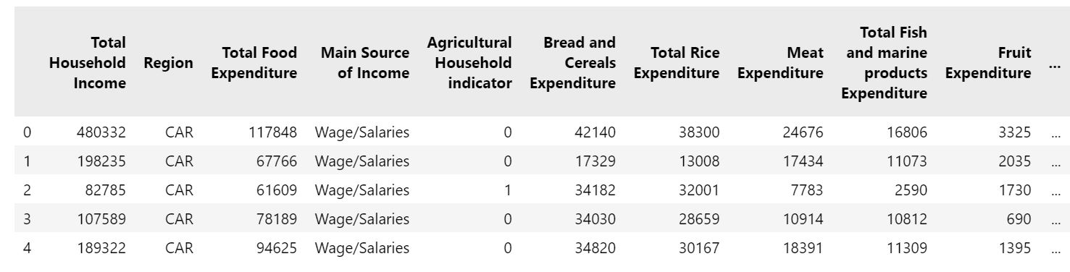
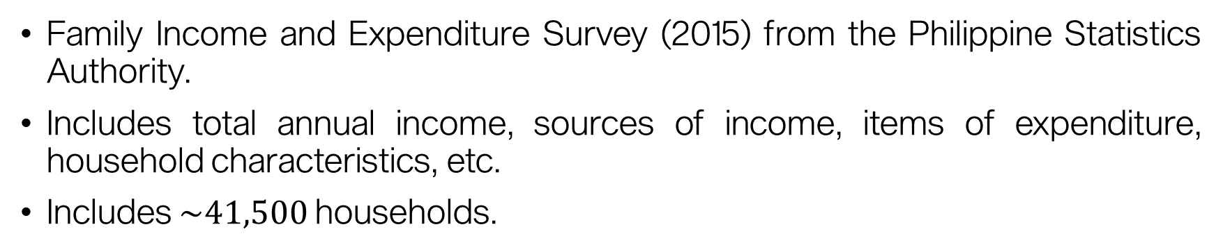
About the data
Family Income and Expenditure Survey (2015) from the Philippine Statistics Authority.
Includes total annual income, sources of income, items of expenditure, household characteristics, etc.
Includes $\sim 41,500$ households.

Slide 3
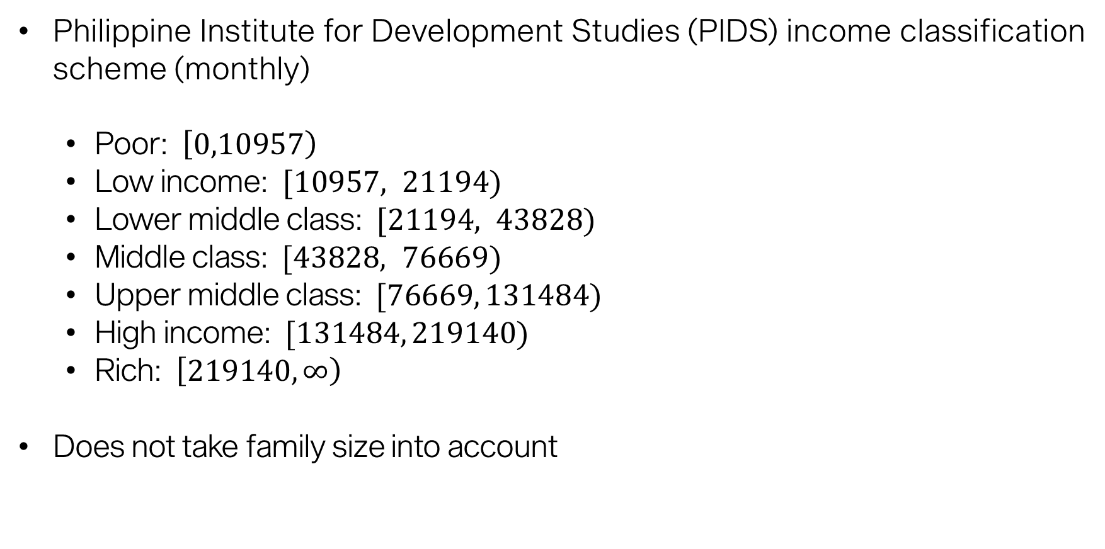
Income inequality
Philippine Institute for Development Studies (PIDS) income classification scheme (monthly)
Poor: $\left[0,10957\right)$
Low income: $[10957, 21194)$
Lower middle class: $[21194, 43828)$
Middle class: $[43828, 76669)$
Upper middle class: $[76669, 131484)$
High income: $[131484, 219140)$
Rich: $\left[219140,∞\right)$
Does not take family size into account

Slide 4
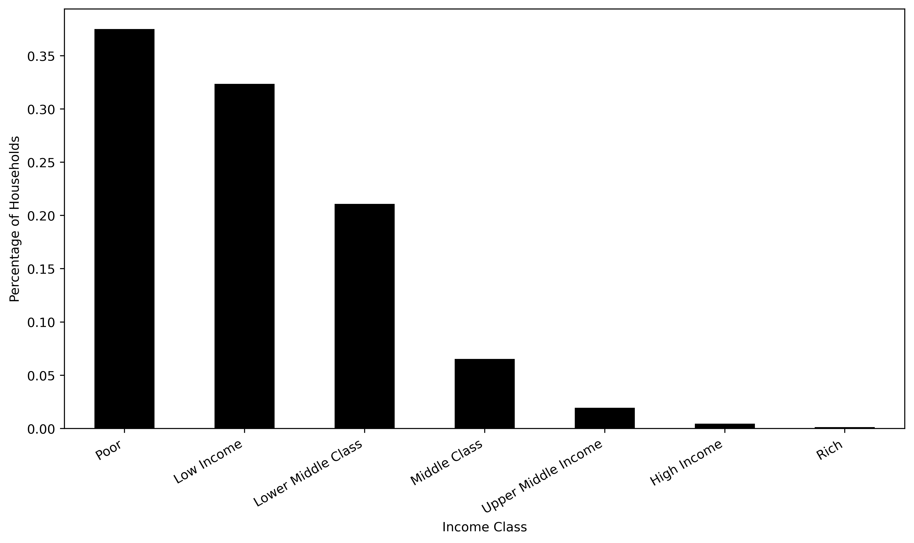
Income inequality
Majority of Filipinos are poor.
Philippine Institute for Development Studies (PIDS) income classification scheme

Slide 5
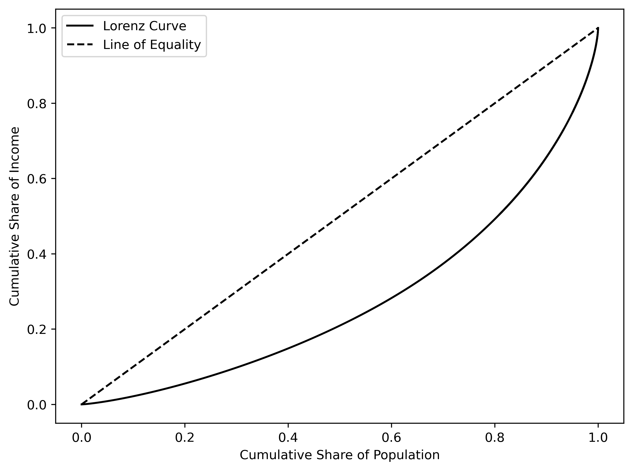
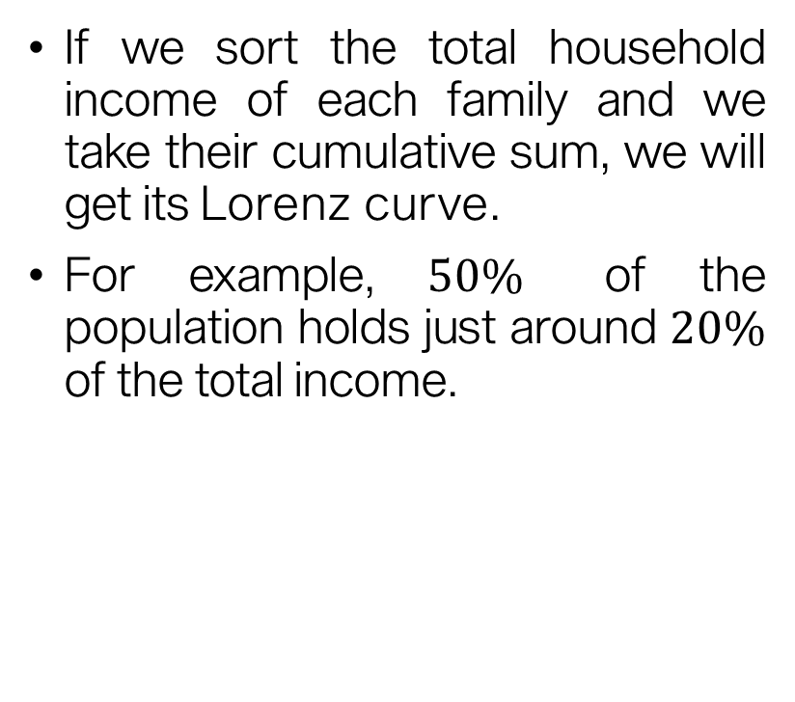
Income inequality
If we sort the total household income of each family and we take their cumulative sum, we will get its Lorenz curve.
For example, $50\%$ of the population holds just around $20\%$ of the total income.

Slide 6
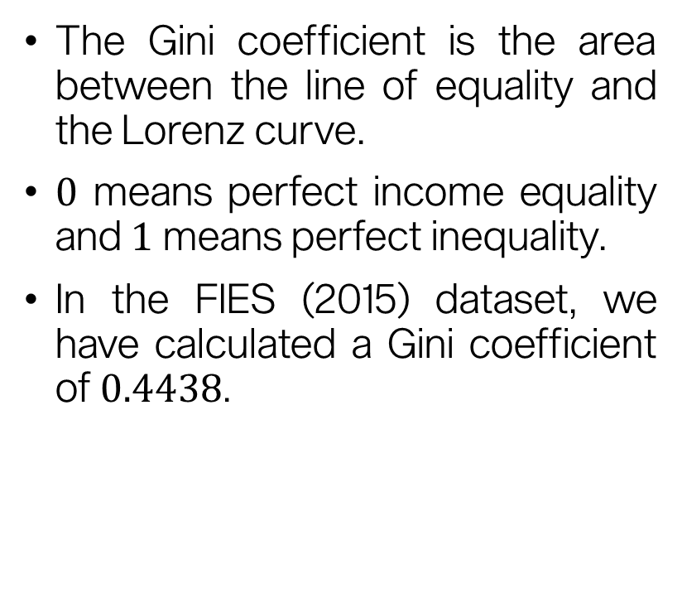
Income inequality
The Gini coefficient is the area between the line of equality and the Lorenz curve.
$0$ means perfect income equality and $1$ means perfect inequality.
In the FIES (2015) dataset, we have calculated a Gini coefficient of $0.4438$.

Slide 7
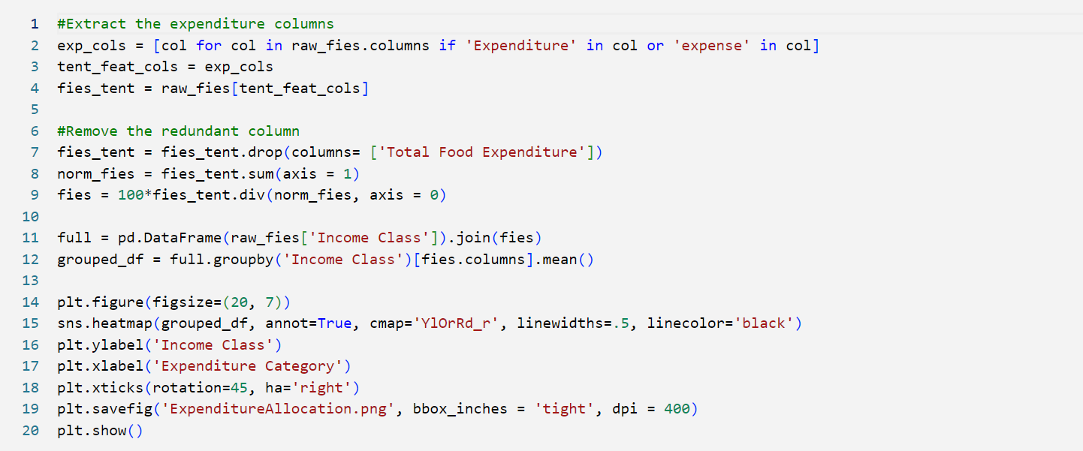
Expenditure allocation

Slide 8
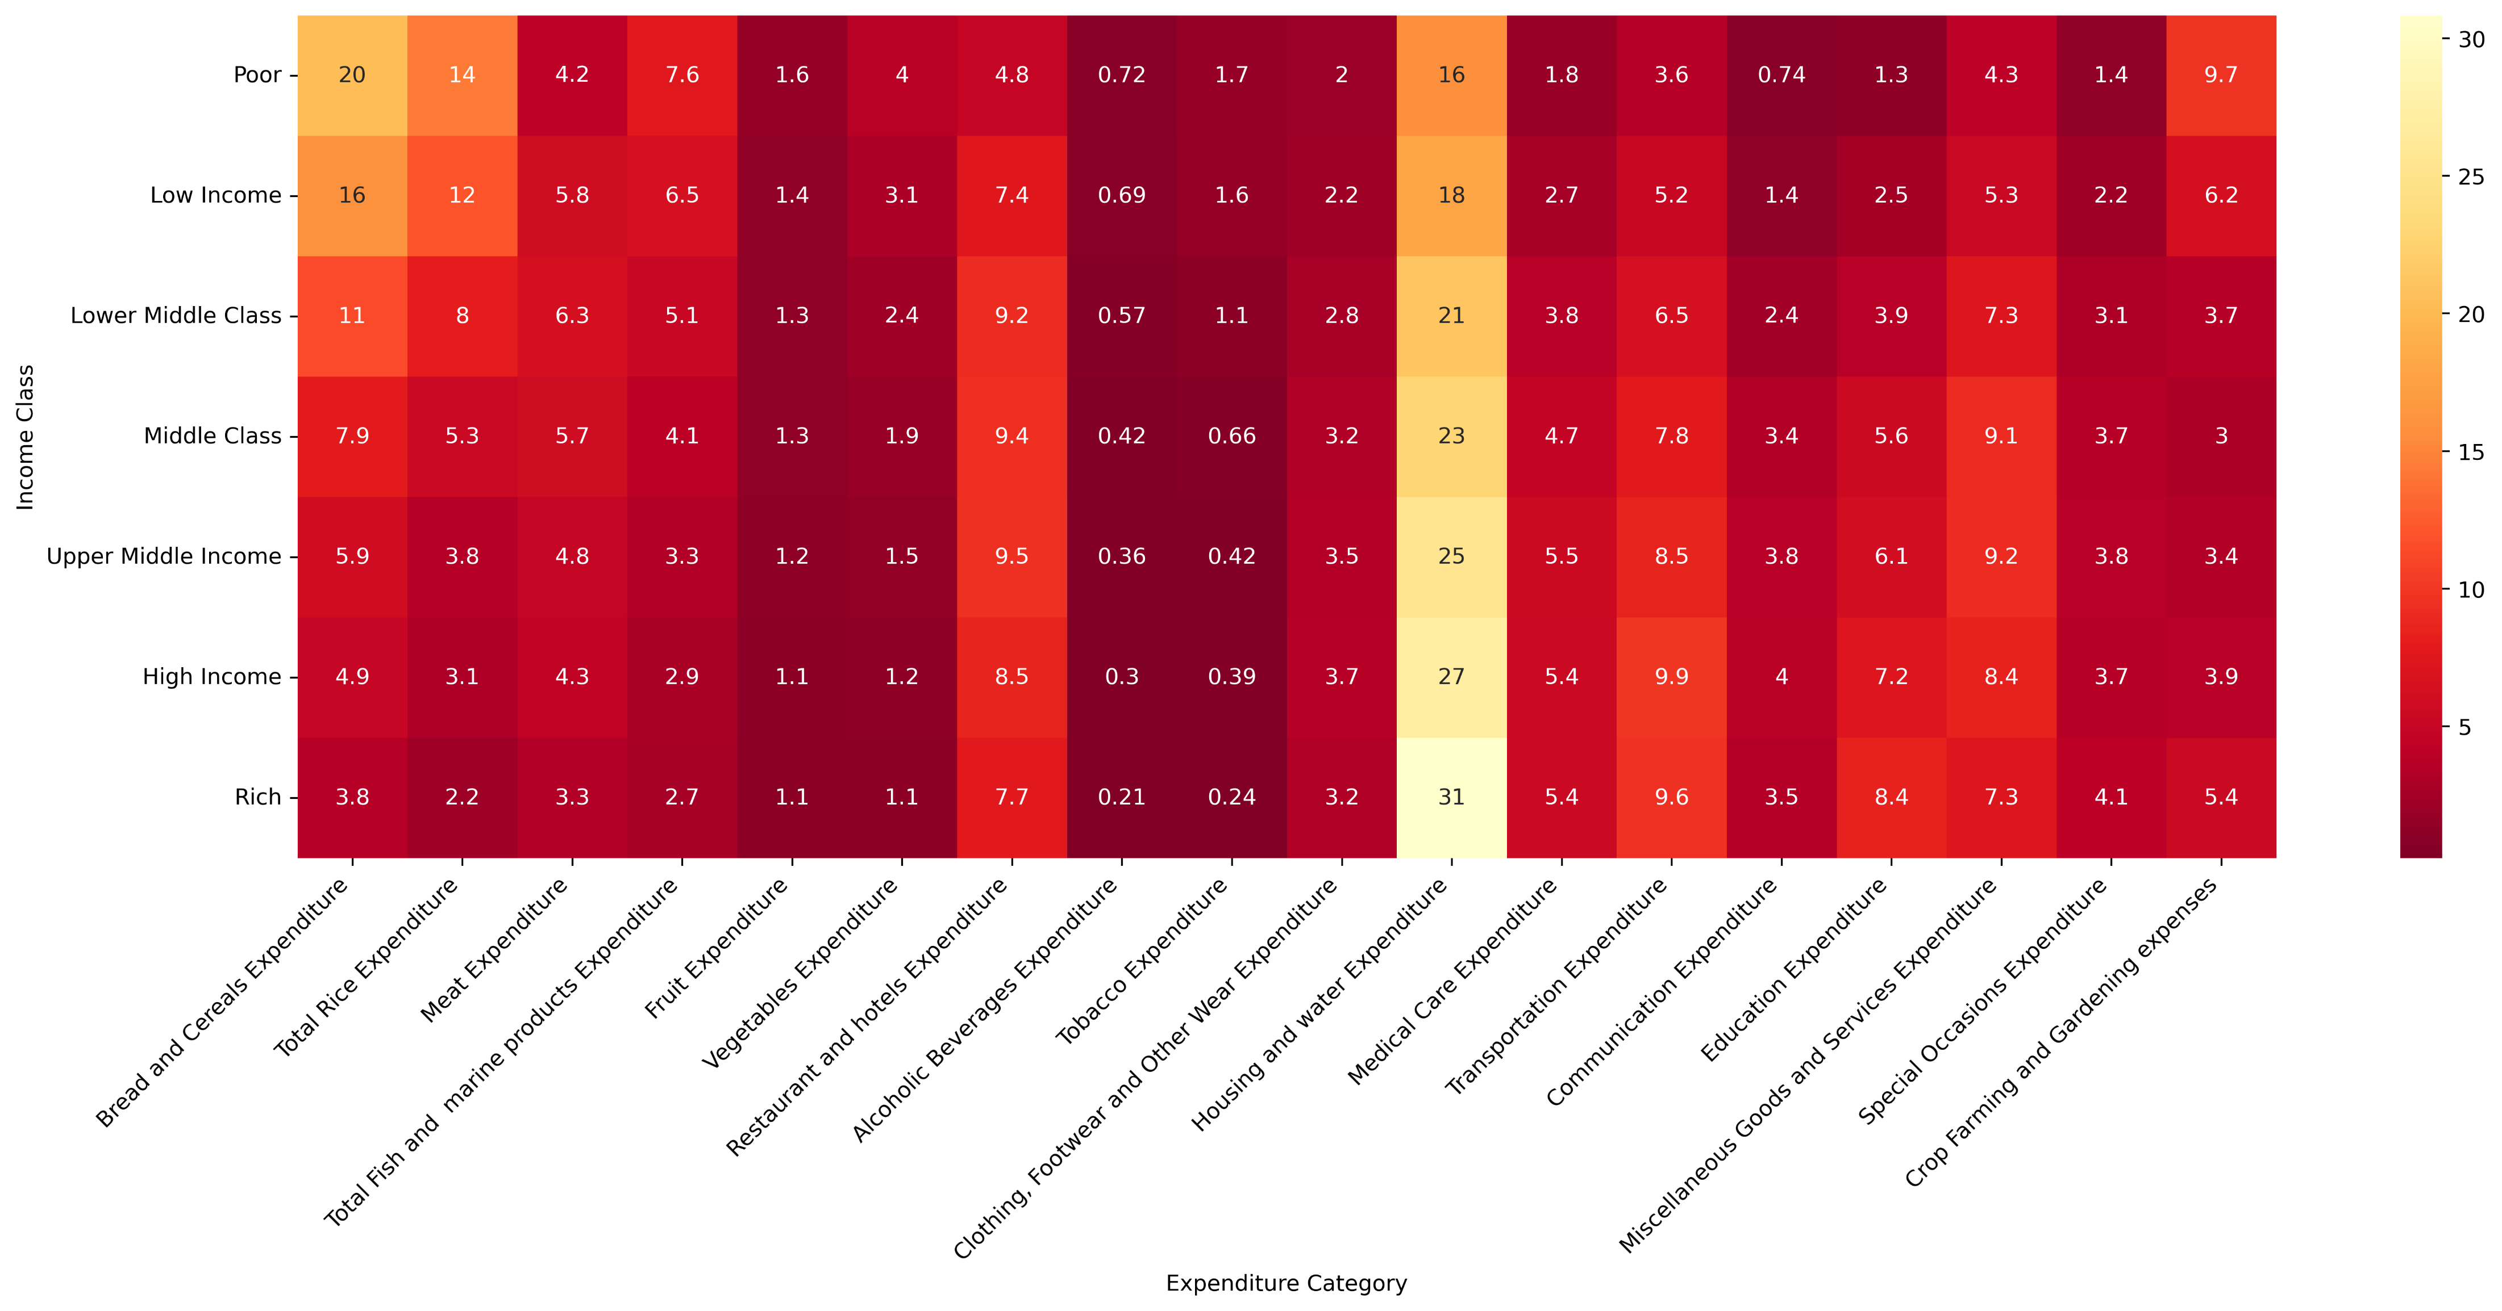
Expenditure allocation

Slide 9
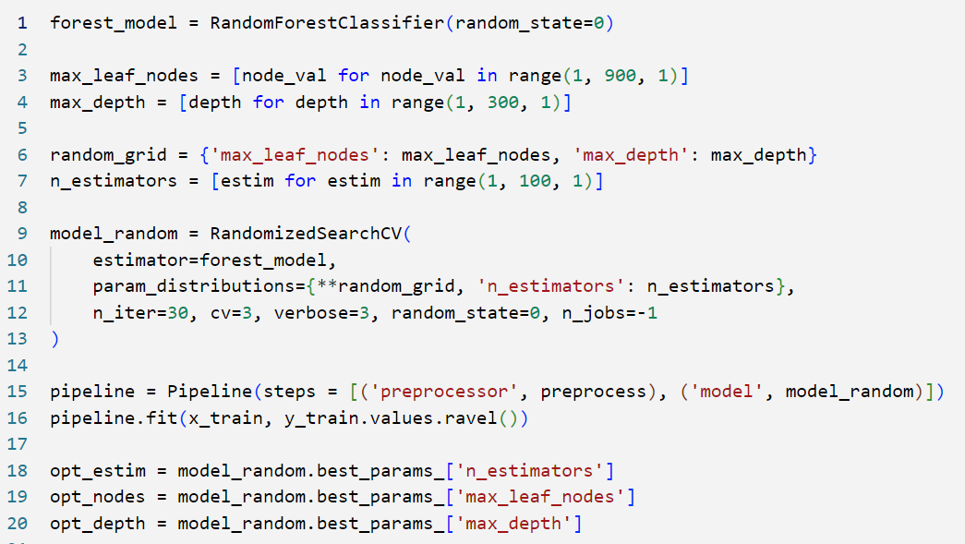
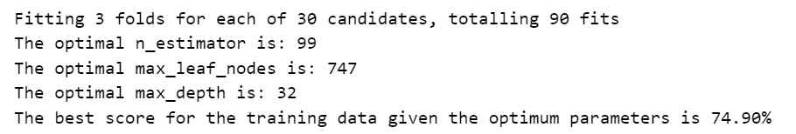
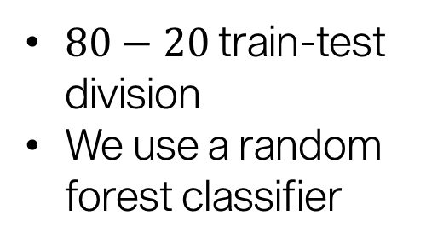
Prediction Model
$80−20$ train-test division
We use a random forest classifier

Slide 10
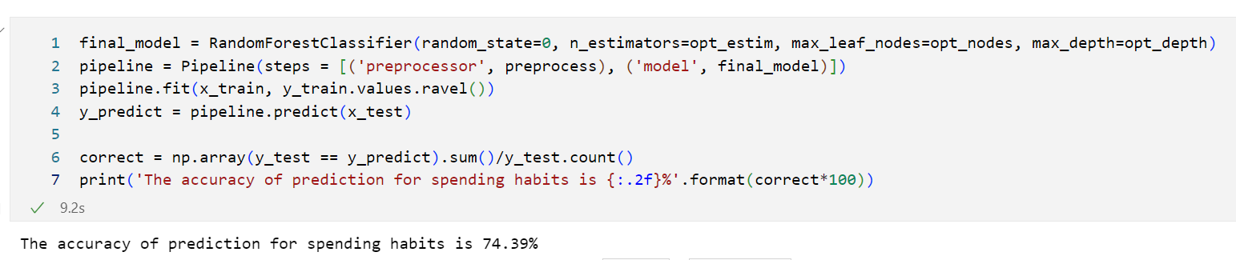
Prediction Model

Slide 11
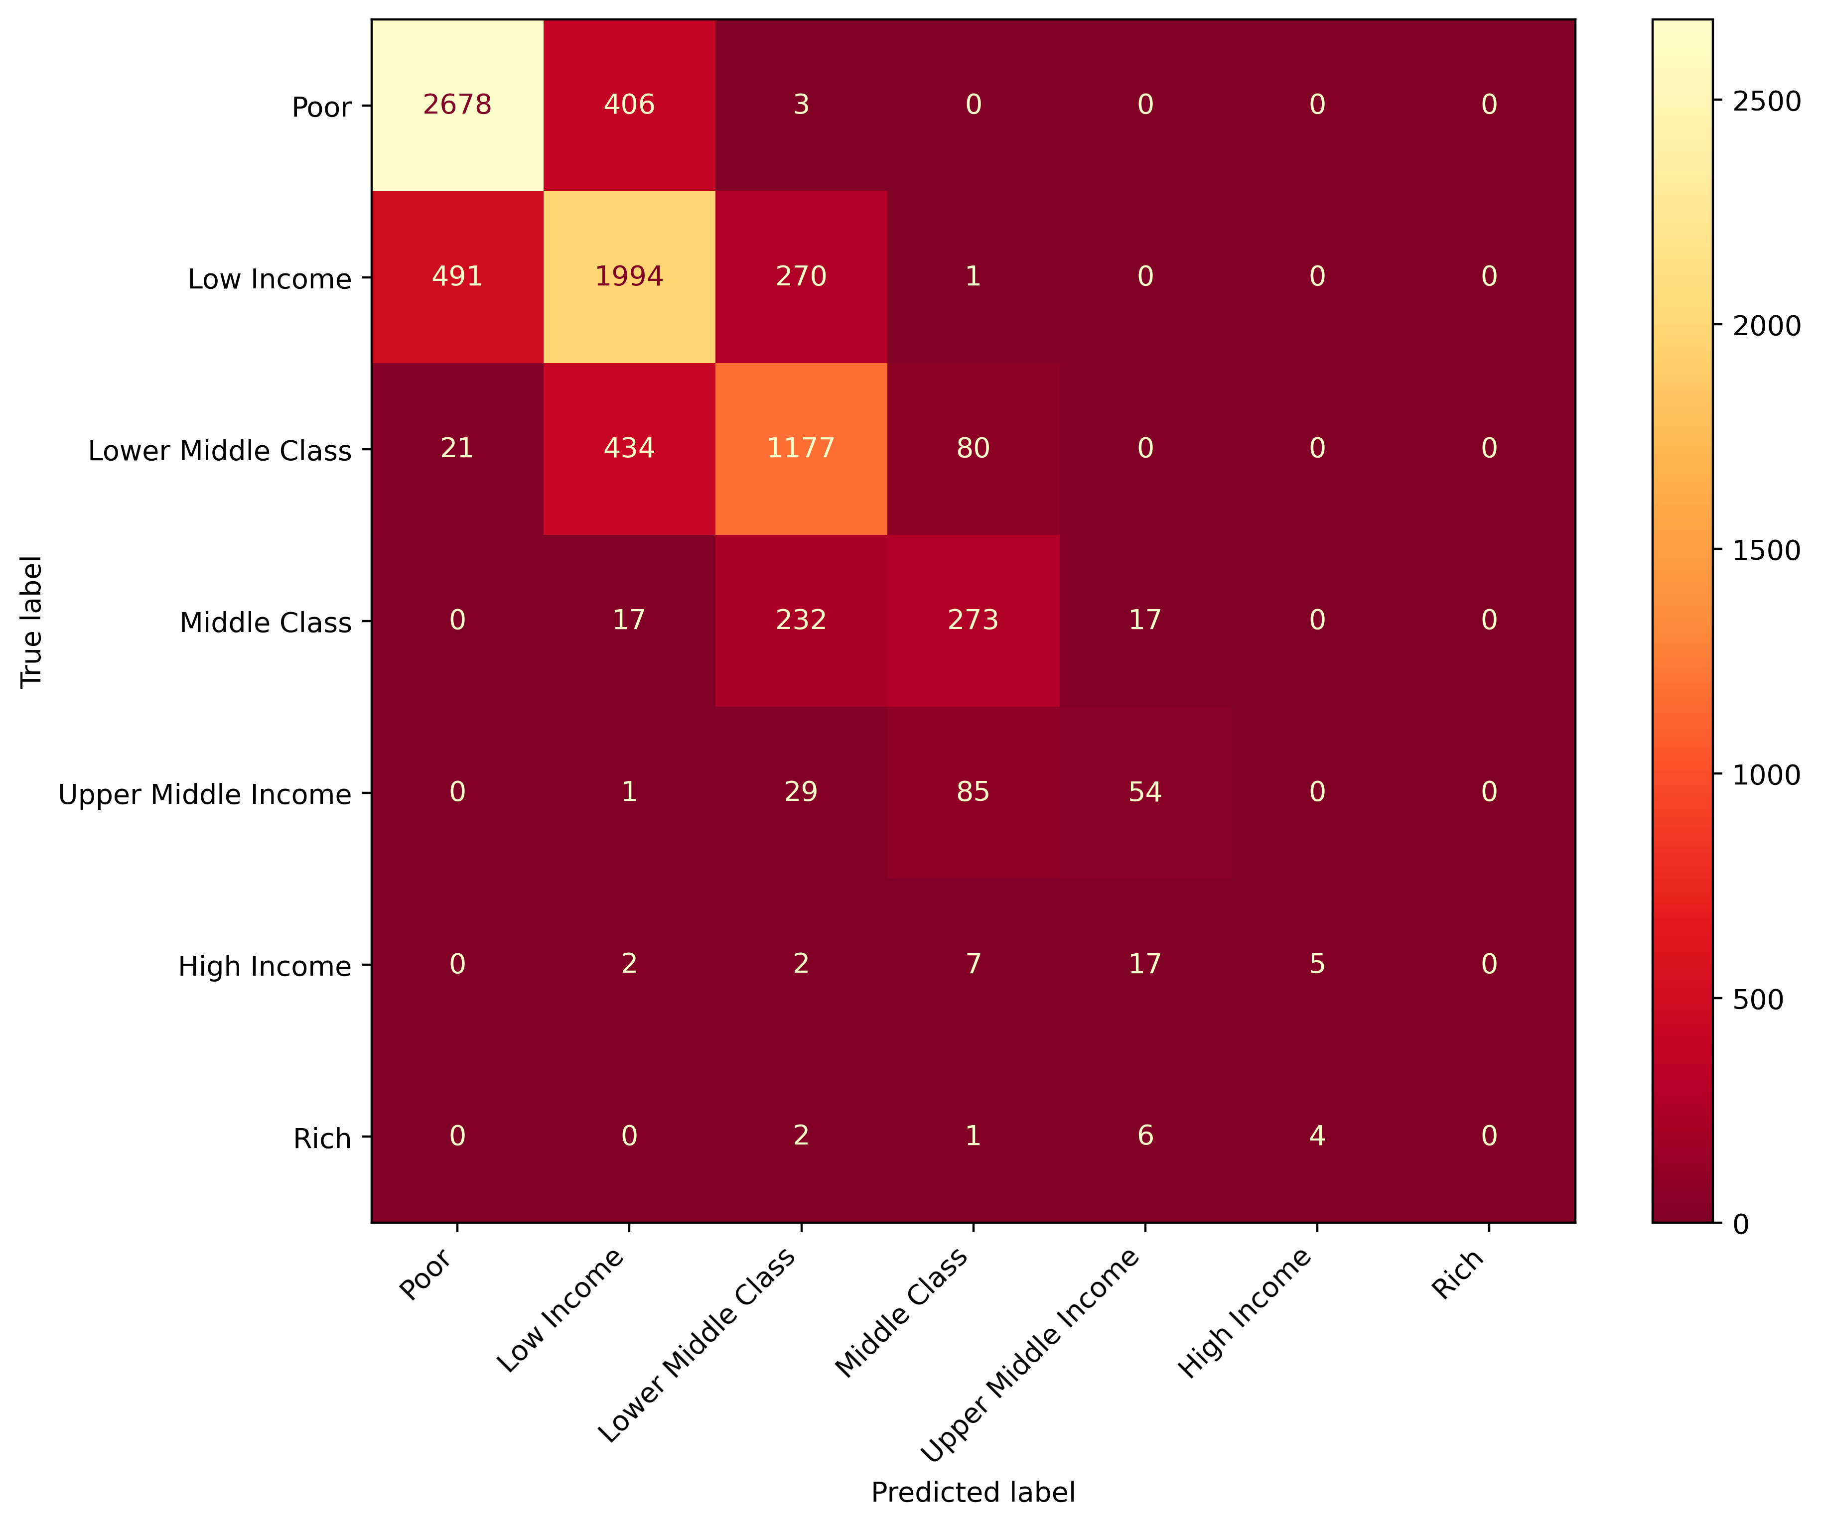
Prediction Model
The model fails to classify higher classes accurately!

Slide 12
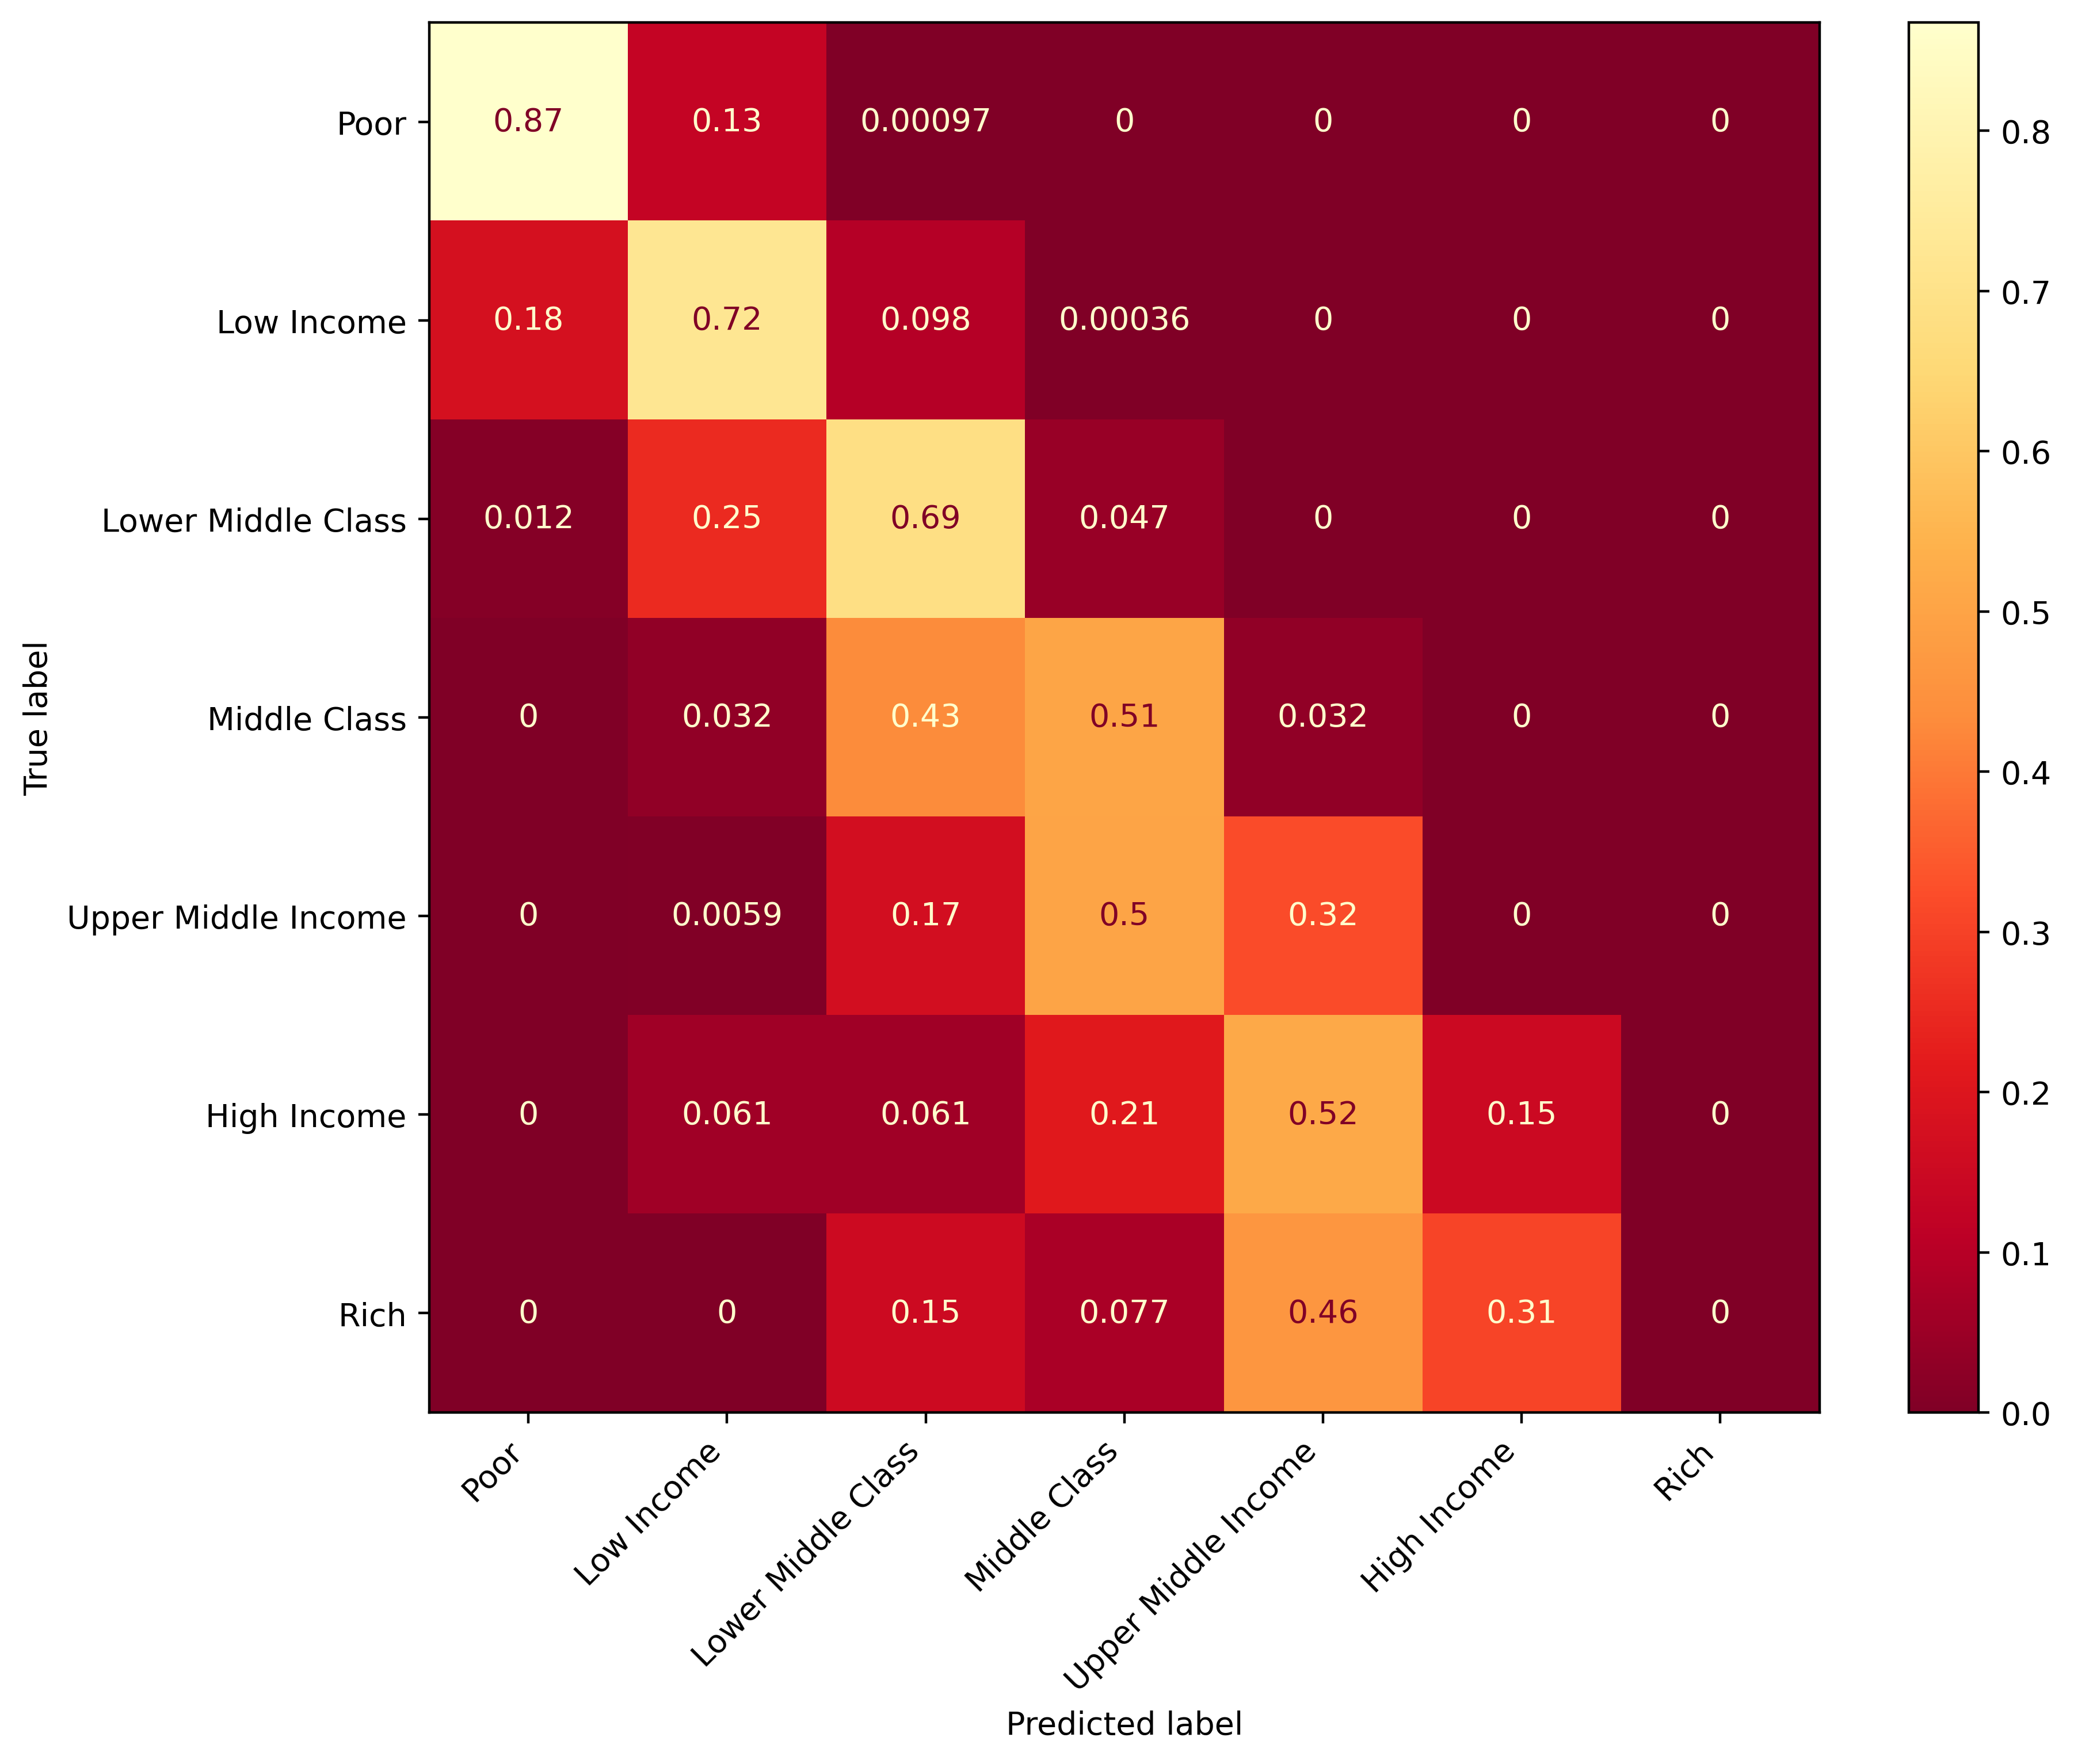
Prediction Model
The model fails to classify higher classes accurately!

Slide 13
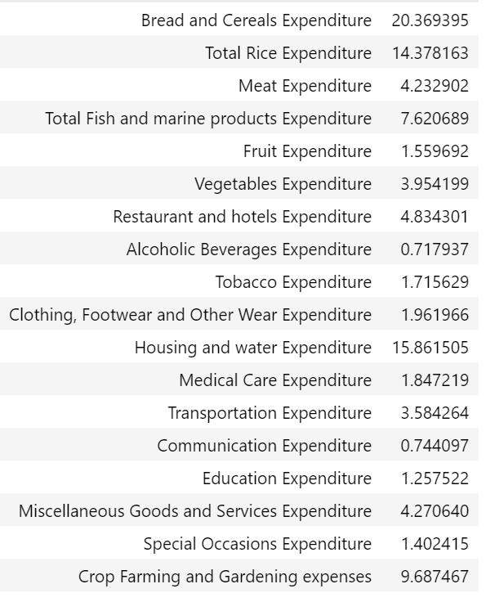
Synthesis
The spending behavior of higher income classes are less unpredictable.
The budget allocation for lower income classes are consistent.
This may imply that the items with higher expenditure proportions must be the key areas to focus on if we want to address the effects of income inequality.

Slide 14
End

